Slide 1
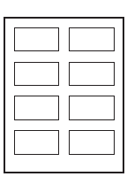
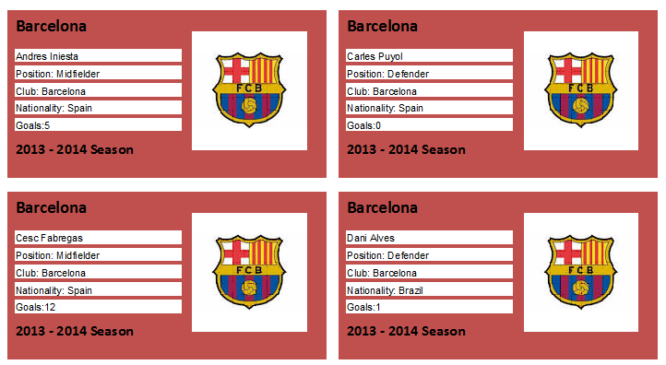
Produce labels from all the data which: Are arranged in two columns Show only the records where the club is Barcelona Sort the clubs into Names into Ascending order Show only the fields Name, Position, Club, Nationality and Goals each on a separate line Display the field name as well as the data apart from the Name Field. Include the heading Barcelona - in a larger font at the top of each label (Size 14, Bold and Black) 2013 – 2014 Season should appear at the bottom of each label. (Size 12, Bold and Black) The Barcelona logo should appear on each label to right of the text. Format the background with a suitable colour (Maroon or Blue).
Example Label:

